Slide 1
AI WARRIORS
Tourism Travel Chatbot with
Voice Assistant
Team Captain Name: N .Uma Maheswararao

Slide 2

Domain & Problem Statement
Domain
Artificial Intelligence & Machine Learning
Problem Statement
The problem is the time-consuming and overwhelming process of travel planning for many travelers ,which can be solved by a tourism chatbot using a voice assistant with multi languages that provides personalized and efficient travel planning assistance.

Slide 3
Idea/Solution
The Idea behind the problem statement is to address the challenges that travellers face in researching and planning their trips, such as time-consuming and overwhelming processes.
The solution aims to provide a convenient and personalized way for travellers to plan their trips through a tourism chatbot using a voice assistant, which can reduce the time and effort required for travel planning and enhance the overall travel experience.

Slide 4
Idea/Solution
Our solution is an AI-powered tourism chatbot using a voice assistant that provides personalized travel recommendations and assistance to travellers.
The chatbot could be designed to help travelers plan their trips from start to finish. This could include providing recommendations for destinations, suggesting transportation options, and recommending hotels and activities.
To make the chatbot more personalized, it could be programmed to ask travelers a series of questions about their travel preferences, such as the type of trip they are looking for, their budget, and any special requirements they may have.

Slide 5


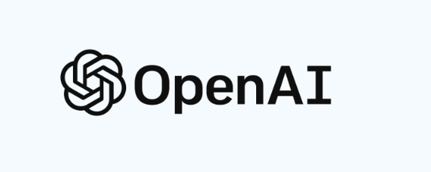

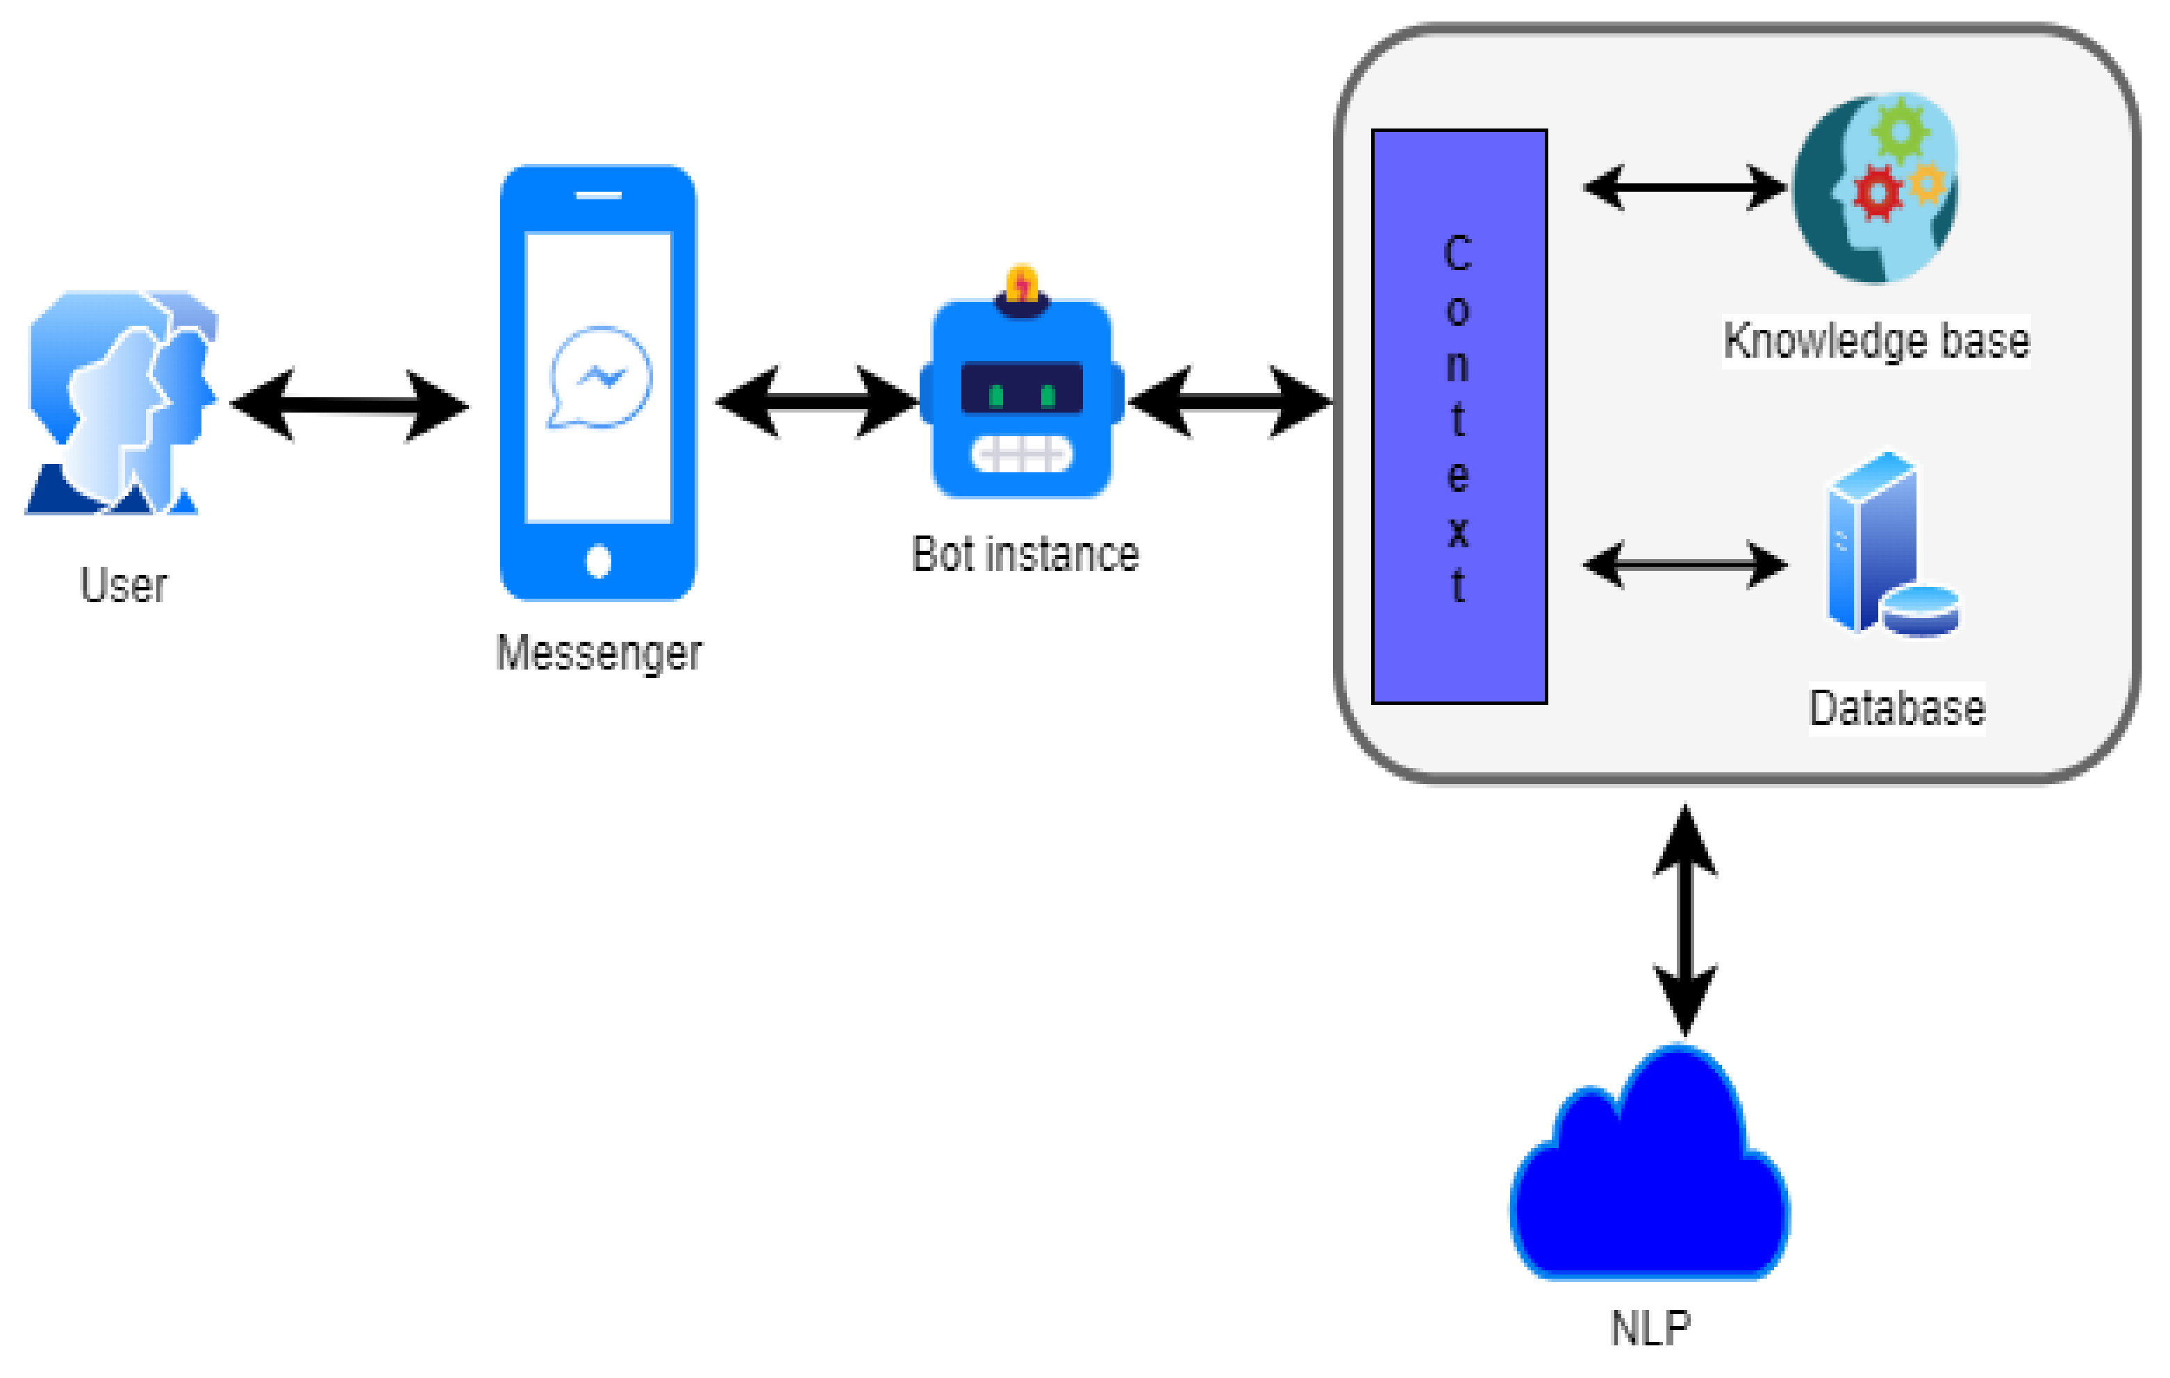






Flowchart
Voice/Text
User
Device
Chatbot

Slide 6
Flow chart of chatbot process
Place to visit
In which month user prefer to visit
Requirements of user
Do you want us to help with schedule trip/best places
Open AI
Satisfied or not
no
yes
Thank you ,visit again

Slide 7
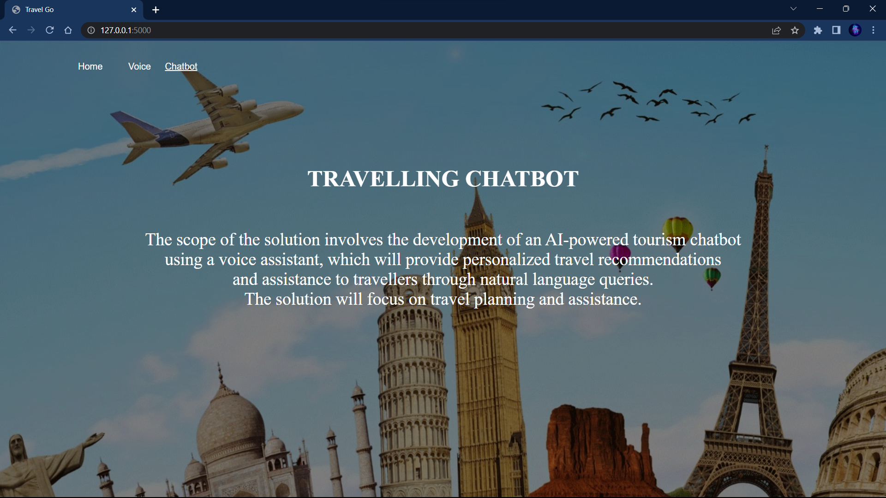
Results:

Slide 8
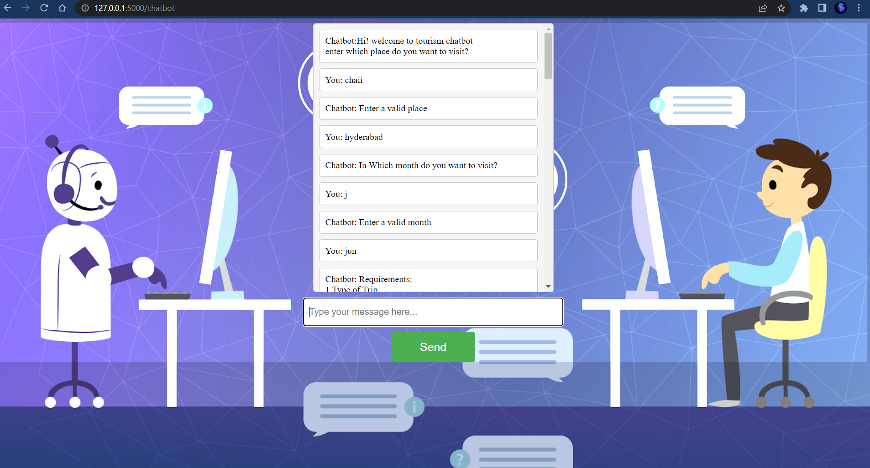

Slide 9
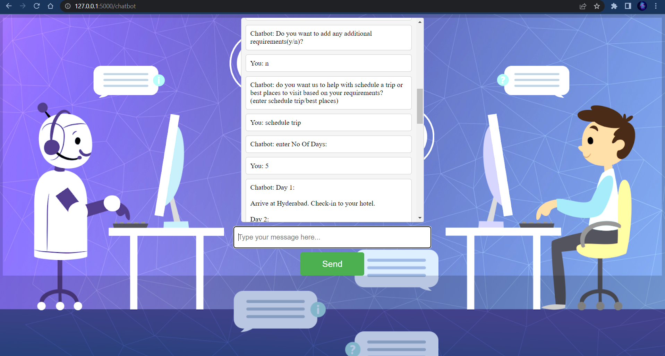

Slide 10
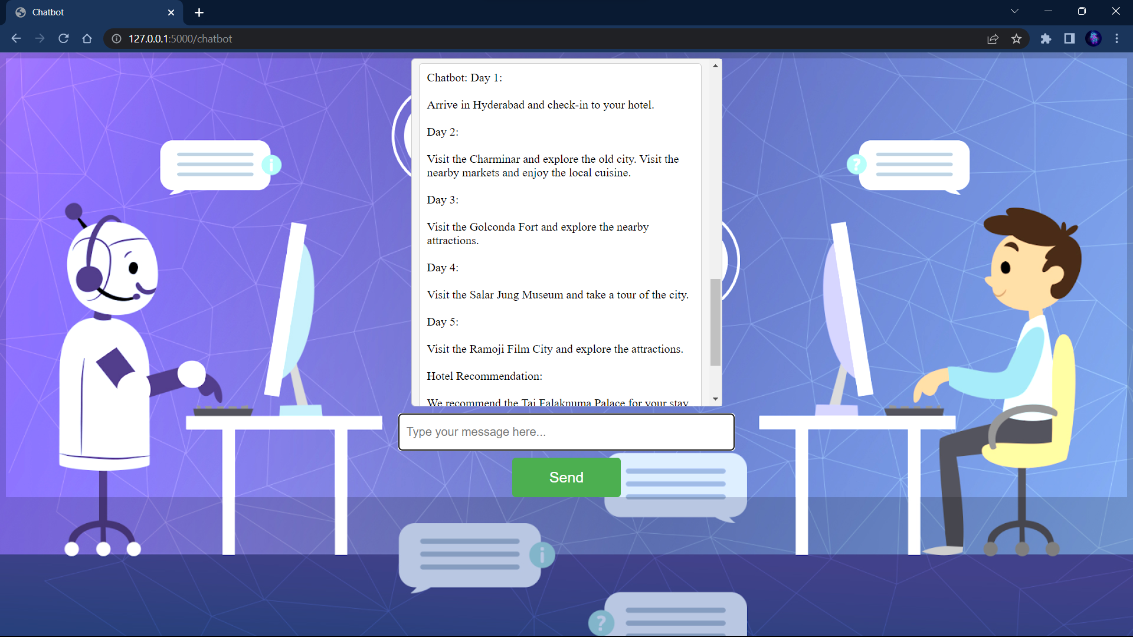

Slide 11
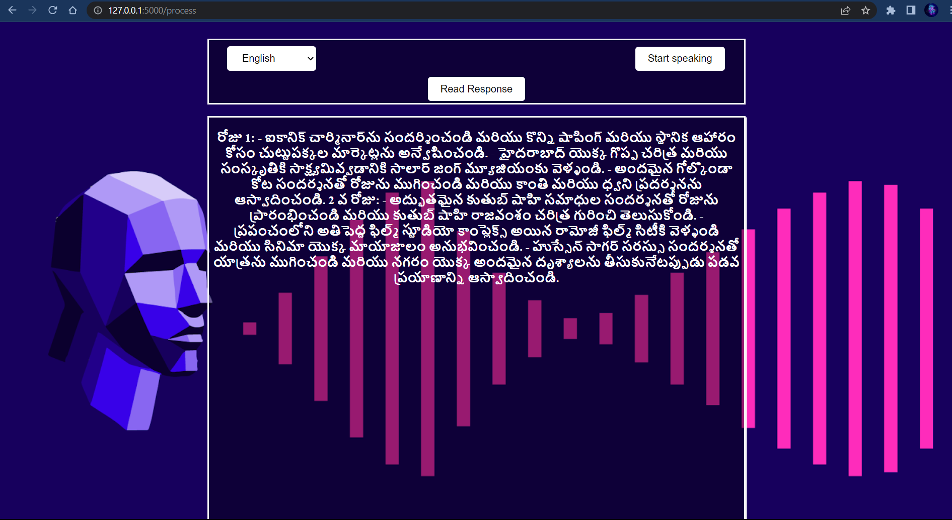

Slide 12
Dependencies:
Stable Connection
User must have a device(PC)
Web Browser is needed to access the chatbot
Drawbacks:
Our chatbot will work perfectly but if there is internet issue then it will give delay in response.
Right now we didn`t deployed our chatbot in cloud

Slide 13
Tech Stack
Natural Language Processing
Python, Flask
Html, CSS, Javascript
Suggestions:
1.They asked atleast 3 languages(telugu,hindi,English)
2. When user enters invalid input they asked for the restriction
3.Asked about novelty and impact on society

Slide 14
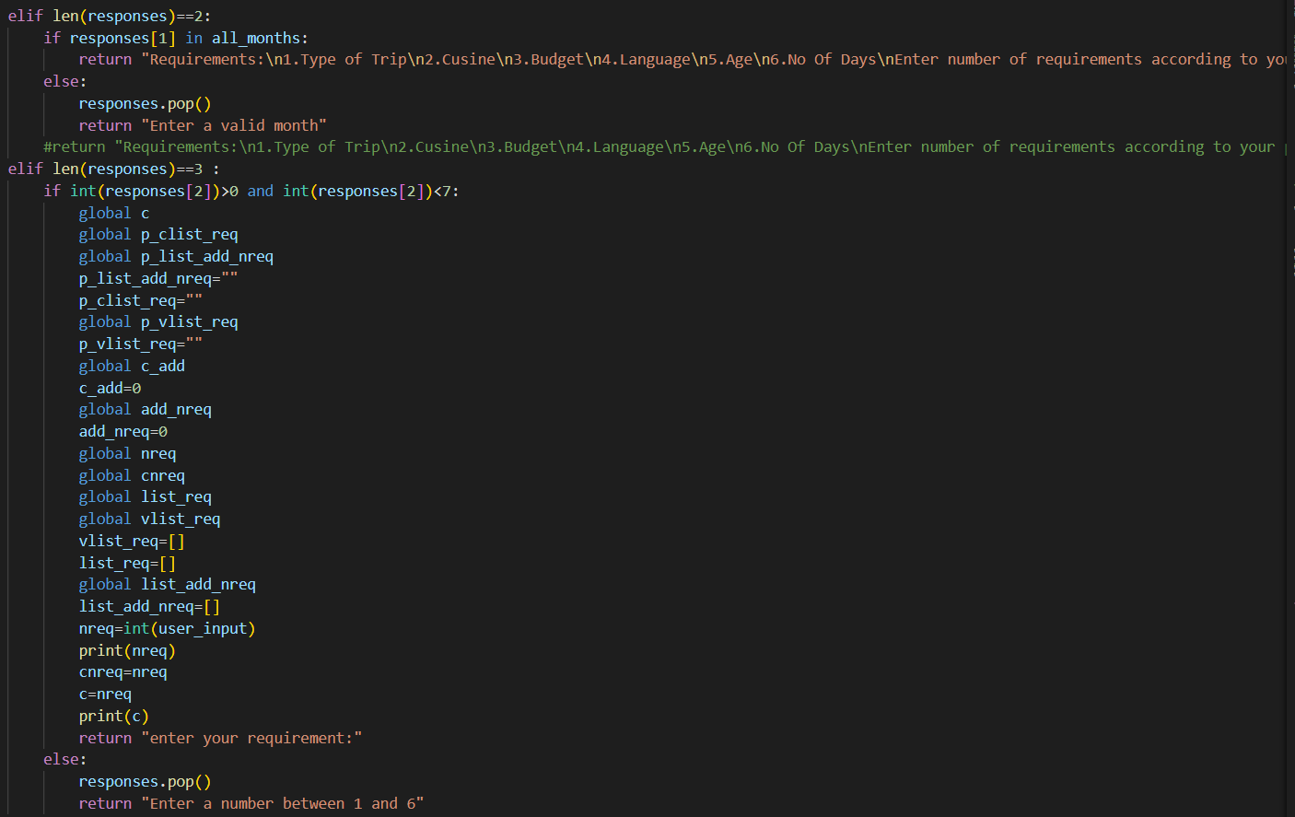
Solutions:
1. We have used googletrans api to translate into multiple languages
2. We have successfully restricted invalid input from user
3.We provide multiple language interface through voice.
we ask personalized requirements based on user preference and provide response which is not at implemented in any tourism chatbot

Slide 15
THANK YOU!

